Slide 1










Resume Project Challenge
GoodCabs
Analysis
Let’s Drive the Future of Mobility Together!
Presentation
Presented By:
Vkas Rajpurohit
https://www.youtube.com/@blink_analytix
https://www.linkedin.com/in/vkas-rajpurohit/

Slide 2

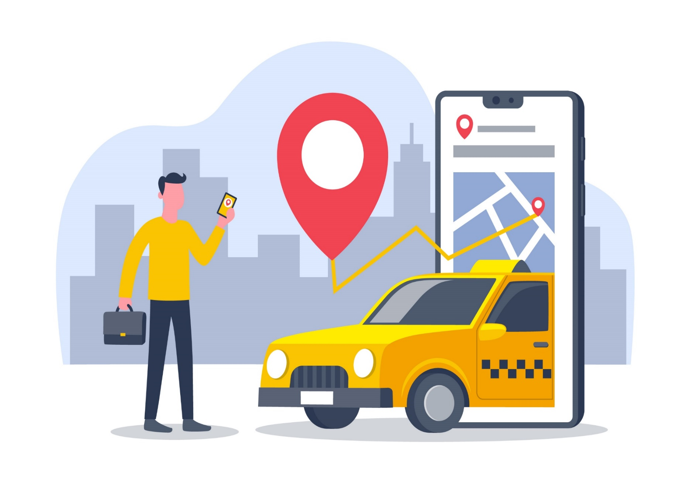

Overview
1
Introduction
Excel Integration
BR- 1: City-Level Fare and Trip Summary Report
BR- 2: Monthly City-Level Trips Target Performance
BR- 3: City-Level Repeat Passenger Trip Frequency
BR- 4: Identify Cities with Highest/Lowest Total New Passengers
BR- 5: Identify Month with Highest Revenue for Each City
BR- 6: Repeat Passenger Rate Analysis
Further Analysis & Recommendations
Factors Influencing Repeat Passenger Rates
2
3
4
5
6
7
8
9
https://www.youtube.com/@blink_analytix

Slide 3
Overview
10
Tourism vs. Business Demand Impact
Emerging Mobility Trends & Goodcabs’ Adaptation
Partnership Opportunities with Local Businesses
Data Collection for Enhanced Data-Driven Decisions
Conclusion
11
12
13
14
15
16
17
18
https://www.youtube.com/@blink_analytix

Slide 4



1
INTRODUCTION
Goodcabs: Redefining Cab Services in Tier-2 Cities
Established: 2 years ago, in 2022.
Focus: Empowering local drivers in tier-2 cities to ensure sustainable livelihoods and exceptional passenger service.
Presence: Operating in 10 tier-2 cities across India.
Vision for 2024: Achieving ambitious growth targets and enhancing passenger satisfaction.
Your trusted partner for reliable and community-driven transportation.
2
3
4
5
6
7
8
9
GOODCABS.CO
https://www.youtube.com/@blink_analytix

Slide 5
Excel Integration
1
2
3
4
5
6
7
8
9
https://www.youtube.com/@blink_analytix

Slide 6
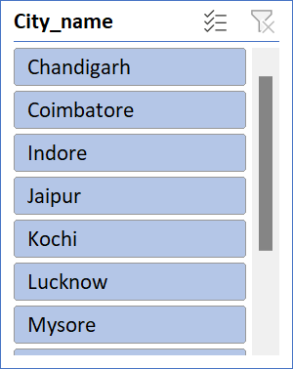
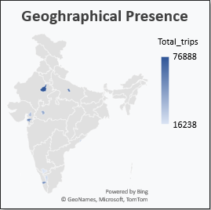
Business Request - 1:
City-Level Fare and Trip Summary Report
1
2
3
4
5
6
Highlights:
Highest contribution to total trip is the 18.05 % which is for Jaipur city.
Jaipur city is the top performing city, there is highest total trips, avg fare per km as well as avg fare per trip.
Mysore has the lowest total trips.
Avg fare per trip is the lowest for Surat city, avg fare per km is the lowest for Vadodara city.
Suggestions:
For Mysore city - avg fare is good, need to focus on trips count increment.
For Surat & Vadodara city - avg fare is the lowest, need plans to improve this.
7
8
9
https://www.youtube.com/@blink_analytix

Slide 7
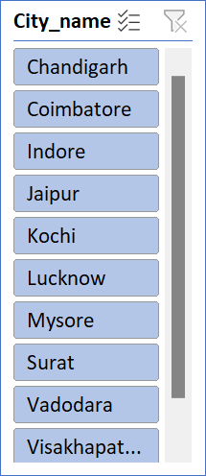


Business Request - 2:
Monthly City-Level Trips Target Performance
1
2
3
4
5
6
Highlights:
Mysore city exceeded the target to 127.38%.
Vadodara city is the worst performing city, missed all the target; achievement rate is -87.29%.
Apart from Vadodara city, Lucknow city also missed all the target for each month.
June month is the worst performing month ; out of 10, 7 cities missed the target.
Kochi & Vadodara city doing worst in the June month.
Suggestions:
For Mysore city - able to achieve target, need to set new targets.
For Vadodara & Lucknow city - need immediate attention, not even a single target met.
Need to identify reason for the June month lowest performance, and take action accordingly.
7
8
9
https://www.youtube.com/@blink_analytix

Slide 8
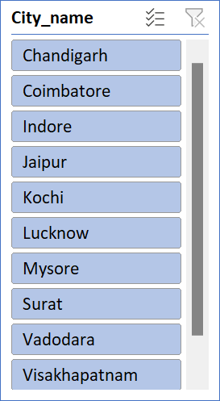
Business Request - 3:
City-Level Repeat Passenger Trip Frequency
1
2
3
4
5
6
Highlights:
Highest repeat passengers trip frequency is the 2-Trips i.e. 51.25%.
Avg repeat passenger trip frequency is 6-Trips i.e. 20.18%.
Suggestions:
2-Trips RPR% is good, now need to focus on increasing RPR% for 3-Trips & 4-Trips.
7
8
9
https://www.youtube.com/@blink_analytix

Slide 9

Business Request - 4:
Cities with Highest/Lowest Total New Passengers
1
2
3
4
5
6
Highlights:
Among the top 3 cities by new passengers, Jaipur have the highest new passengers' number i.e. 45,856.
Among the bottom 3 cities by new passengers, Coimbatore have the lowest new passengers' number i.e. 8,514.
Suggestions:
Need to focus on bottom 3 cities by new passengers, to acquire new passengers.
7
8
9
https://www.youtube.com/@blink_analytix

Slide 10
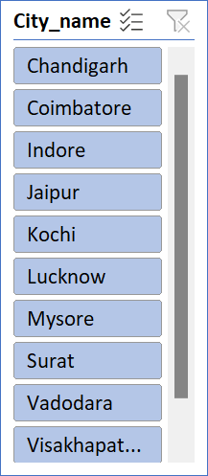
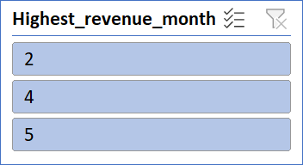
Business Request - 5:
Identify Month with Highest Revenue for Each City
1
2
3
4
5
6
7
Highlights:
Highest Revenue months are Feb, April and May.
Jaipur city generating the highest revenue i.e. 7.75 M, as well the highest contribution i.e. 20.82%.
Coimbatore City generating the minimum revenue i.e. 0.61 M, and contribution is 17.38%.
Suggestions:
For Coimbatore city - Need to focus on revenue increment.
8
9
https://www.youtube.com/@blink_analytix

Slide 11


Business Request - 6:
Repeat Passenger Rate Analysis
1
2
3
4
5
6
7
Highlights:
May month have the highest number of repeat passengers i.e. 12,167.
Jan month have the lowest number of repeat passengers i.e. 8,343.
Surat city have the highest repeat passenger rate % i.e. 42.63.
Mysore city have the minimum repeat passenger rate% i.e. 11.23, still able to achieve all the targets.
Suggestions:
Mysore city have the minimum repeat passenger rate% i.e. 11.23, still able to achieve all the targets. Mysore city doing good, we can plan to generate more revenue.
8
9
https://www.youtube.com/@blink_analytix

Slide 12
Further Analysis & Recommendations
Factors Influencing Repeat Passenger Rates
1
2
3
Key Factors:
Quality of Service: Cleanliness, professionalism, punctuality, safety.
Pricing and Discounts: Competitive pricing, loyalty programs, promotions.
City Demographics: Income levels, employment status, access to alternate transportation.
Lifestyle Patterns: Students, professionals, tech-savvy users.
Recommendations :
Use customer feedback to refine service quality.
Implement loyalty programs and targeted promotions.
Conduct demographic analysis to identify high-potential user segments.
4
5
6
7
8
9
https://www.youtube.com/@blink_analytix

Slide 13
Further Analysis & Recommendations
Tourism vs. Business Demand Impact
10
11
Tourism-Related Demand:
Seasonal demand spikes during festivals, events, and holidays.
May month have the highest number of repeat passengers i.e. 12,167, the reason is obvious as the May – Jun months are the tourism months.
Off-peak periods may see reduced trip volume.
Business-Related Demand:
Conferences, trade shows, and corporate events drive demand.
Surat city have the highest repeat passenger rate % i.e. 42.63, the reason is obvious as Surat city is the business hub.
Recommendations :
Event-Driven Marketing: Target tourism seasons and local events.
Dynamic Pricing: Implement surge pricing for high-demand periods.
Partnerships: Collaborate with event organizers for transport options.
12
13
14
15
16
17
18
https://www.youtube.com/@blink_analytix

Slide 14
Further Analysis & Recommendations
Mobility Trends & Goodcabs’ Adaptation
10
11
Emerging Trends:
Electric Vehicle (EV) Adoption: Shift towards EVs and hybrid vehicles.
Green Energy Initiatives: Cities promoting sustainable transport.
Contactless Payments: Digital payment and app-based solutions.
Recommendations :
EV Integration: Pilot electric/hybrid cabs in key cities.
Green Branding: Position Goodcabs as an eco-friendly option.
Tech Upgrades: Improve app for payment flexibility and seamless bookings.
12
13
14
15
16
17
18
https://www.youtube.com/@blink_analytix

Slide 15
Further Analysis & Recommendations
Partnership Opportunities with Local Businesses
10
11
12
Potential Partners:
Hotels & Resorts: Exclusive transport packages for hotel guests.
Shopping Malls: Designated pick-up/drop-off zones.
Event Venues & Stadiums: Exclusive ride services for attendees.
Recommendations :
Jaipur, Lucknow & Surat have high number of total trips, we can apply Strategic Partnerships, Co-Branded Campaigns & In-App Offers in these cities.
Strategic Partnerships: Collaborate with hotels, malls, and event organizers.
Co-Branded Campaigns: Joint promotions with local businesses.
In-App Offers: Exclusive partner promotions via the Goodcabs app.
13
14
15
16
17
18
https://www.youtube.com/@blink_analytix

Slide 16
Further Analysis & Recommendations
Data Collection for Enhanced Data-Driven Decisions
10
11
12
Essential Data to Collect:
Passenger Usage Data: Trip frequency, repeat vs. new passengers.
Customer Feedback & Satisfaction: Feedback, complaint tracking, and ratings.
Trip Data: Routes, delays, cancellations, and efficiency metrics.
Demographic Data: Customer age, profession, and location.
Market Trends: Competitive analysis and industry benchmarks.
Recommendations :
Data Analytics Tools: Use BI tools for key metric tracking.
Customer Segmentation: Leverage demographic data for targeted marketing.
Predictive Analytics: Forecast demand surges during events or peak times.
13
14
15
16
17
18
https://www.youtube.com/@blink_analytix

Slide 17
Conclusion
10
11
12
Key Takeaways:
Enhance repeat passenger rates through improved service and promotions.
Leverage tourism and business demand with targeted marketing.
Adapt to mobility trends with EVs, eco-friendly branding, and tech upgrades.
Foster strategic partnerships with local businesses for mutual growth.
Leverage data-driven strategies to optimize performance and operations.
13
14
15
16
17
18
https://www.youtube.com/@blink_analytix

Slide 18

10
11
12
Let’s Drive the Future of Mobility Together!
13
14
15
THANK YOU..!
16
17
18
https://www.youtube.com/@blink_analytix

